Slide 1

Multimodal Sentiment Analysis with Vision-Language Models
Shubhang Kohirkar, Karan Mudaliar, Sushruth Konapur, Rakshak Kunchum

Slide 2
Multimodal Sentiment Analysis
Multimodal sentiment analysis uses natural language processing and computer vision to understand opinions expressed through both text and images.
This emerging field provides deeper insights than text-based analysis alone by incorporating multiple modes of expression.

Slide 3



A New Era in Sentiment Analysis
Late 1990s
2010s
2013-14
Lexicon-based sentiment analysis introduced
Deep learning models like CNNs and LSTMs applied
Embedding for words revolutionized sentiment analysis (Word2Vec, GloVe)
Early 2000s
Late 2010s
2020s
Supervised machine learning models for sentiment analysis
Multimodal sentiment analysis combining text, audio and video
Large vision-language models like Llama, ViLBERT and BLIP
Ansari, Aseer Ahmad. "Evolution of Sentiment Analysis: Methodologies and Paradigms." (2021)

Slide 4



Why Multimodal Sentiment Analysis on Amazon Reviews
Sentiment analysis is a rapidly growing field
Most past sentiment analysis focused on text data
Images provide additional context
Adding visual data like product images provides useful additional context that can improve sentiment analysis models
Sentiment analysis has become an important tool for analyzing customer opinions and emotions
The majority of past sentiment analysis research utilized only textual data like product reviews
By incorporating both text and images, multimodal sentiment analysis can better understand the nuances of customer opinions.

Slide 5



Challenges in dataset creation
Obtaining enough relevant data
Noisy data
Requires web scraping
Finding product images and reviews that match and collecting a large dataset is challenging
Reviews may not match images or may not express sentiment clearly
Amazon terms prevent scraping so dataset creation requires workarounds
Building a dataset for multimodal sentiment analysis on Amazon reviews poses challenges like finding matched image-text pairs at scale and handling noisy web data.

Slide 6



Tools for Vision-Language Models
Few shot learning
Prompt engineering
BakLLaVA v1 application
Few shot learning aims to learn from limited labeled data, often using a small number of examples to learn new concepts.
Prompt engineering involves carefully designing prompts to elicit desired responses from language models.
BakLLaVA v1 leverages few-shot learning and custom prompt engineeirng to adapt to new domains with minimal labeling
Few shot learning and prompt engineering are key techniques to enable vision-language models to perform well with limited training data.

Slide 7
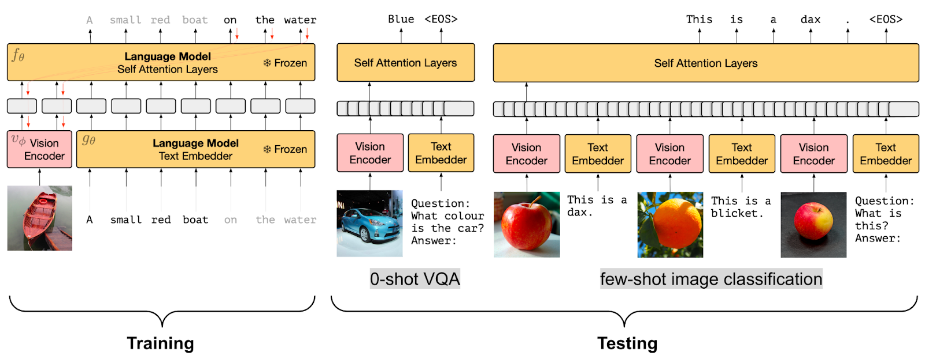
Vision Language Models
Vision language models encode images into feature vectors that represent visual concepts. The models are trained to map images and text into a shared latent space, allowing semantic similarity between visual and textual concepts to be measured.
Huggingface.co, A Dive into Vision-Language Models (2024)

Slide 8
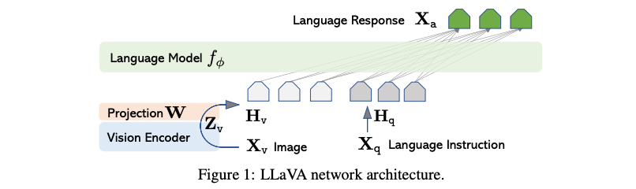
Architecture and Predicting Star Ratings
The trained model can predict product ratings from 1 to 5 stars based on customer reviews and product images. This multimodal approach combines natural language processing of text with computer vision analysis of images to make more accurate predictions than using either data source alone. By learning associations between words, phrases, and image features with star ratings, LLAVA can estimate how likely a customer is to give a product 1, 2, 3, 4, or 5 stars in their review.
Liu, H., Li, C., Wu, Q. and Lee, Y. (n.d.). Visual Instruction Tuning (2024)

Slide 9
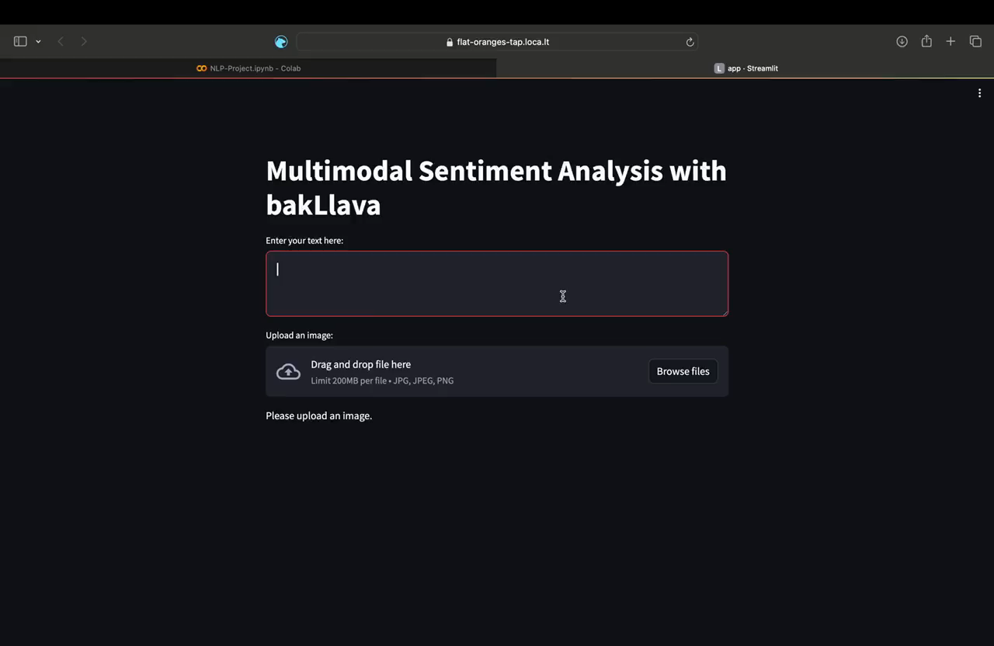

Slide 10
Summary and Conclusion
By combining text, audio and visual inputs, models can now understand meaning and sentiment in a human-like way.
We are close to achieving Artificial General intelligence (AGI) (What a time to be alive!)
Thank you for exploring these exciting innovations with us!

